Slide 1




Pixel Team
Travel Guide

Slide 2

Pixel Team
1
Introduction
2
Team Strategies/Project plan
Today's Agenda
3
Github Collaboration
4
Summary

Slide 3

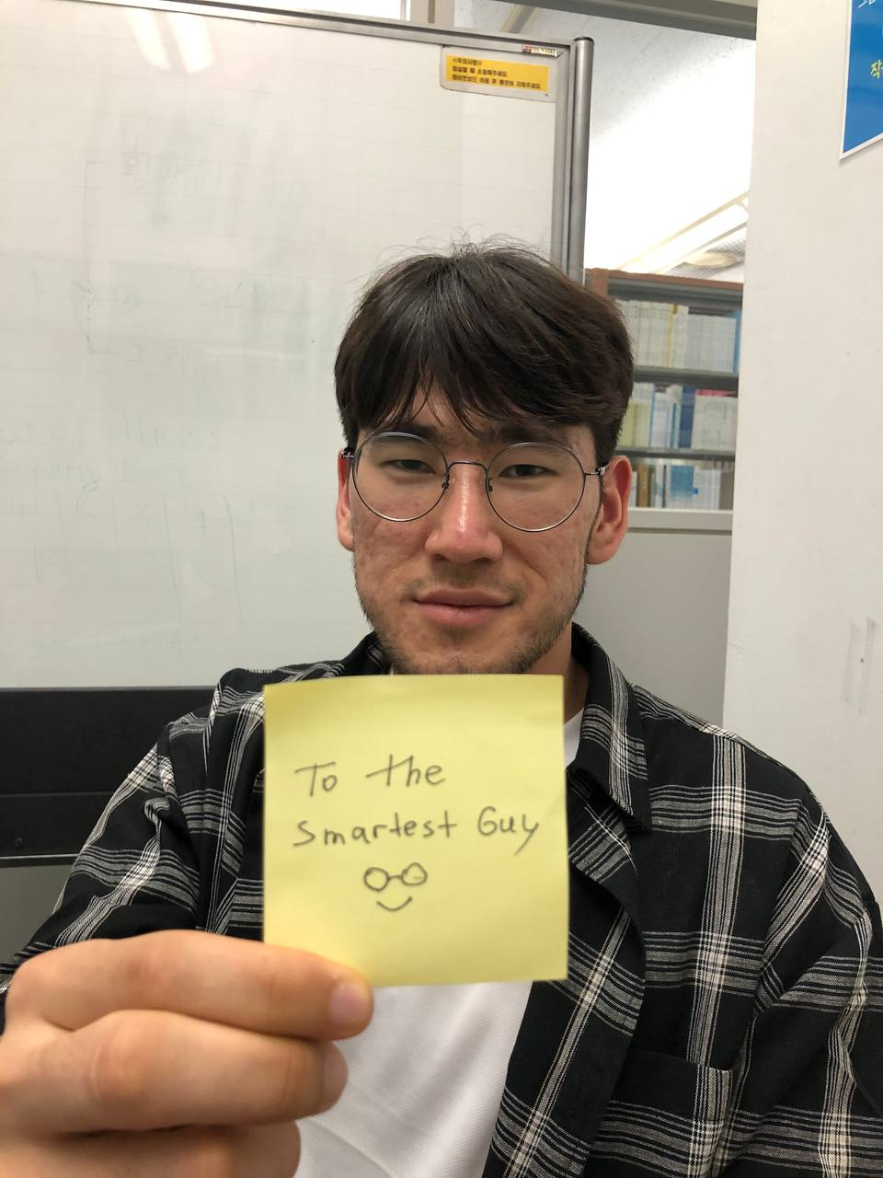
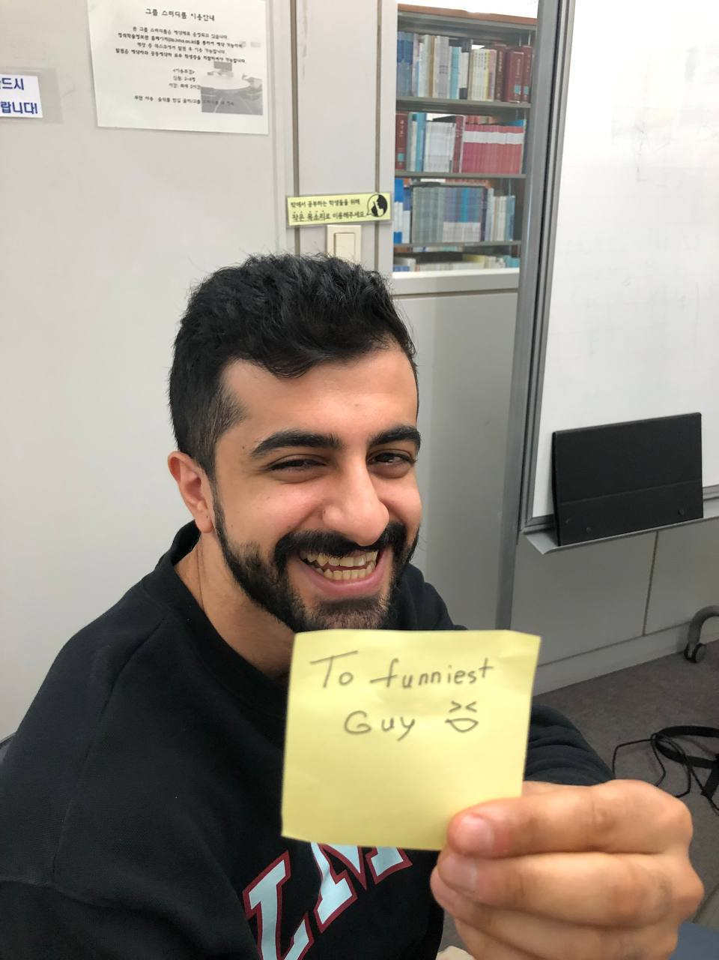
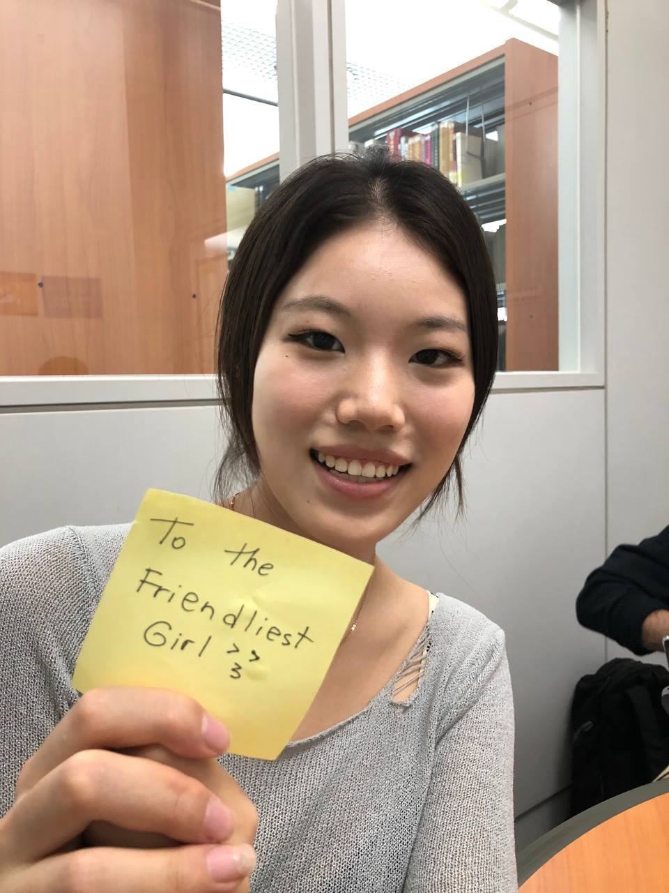
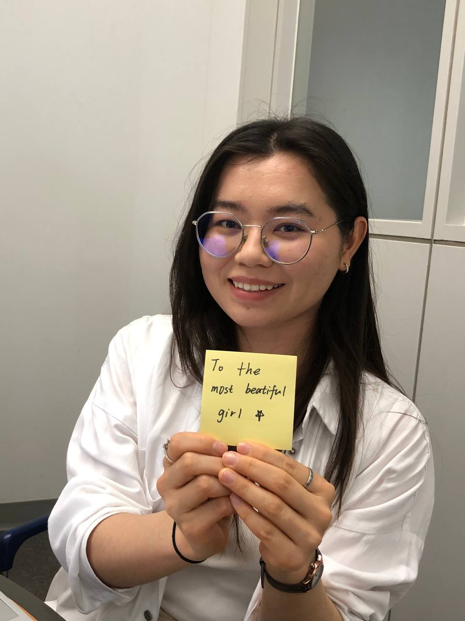
Team Members
Jamshid Ganiev 12200335
Alhammadi Mohamed 12200181
Zhang Xiaomeng 12240121
Diyora Bobokulova
12214731

Slide 4


Pixel Team
Travel Guide Application
An application to find the convenient way to travel
Voice AI Search
AI Chat Bot using GPT-4 API

Slide 5

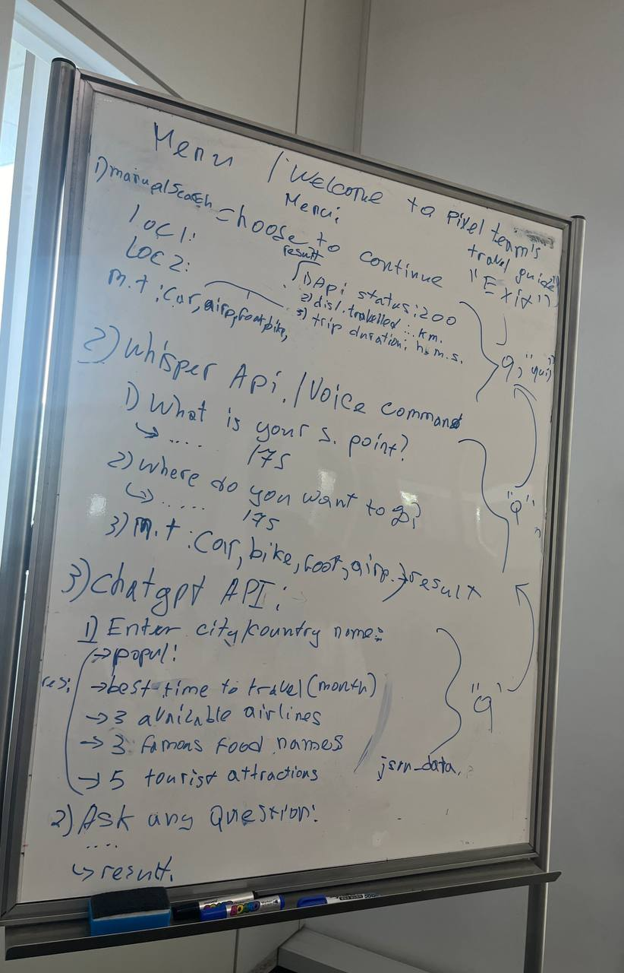

Project Plan
First Project draft
Manual Search (Lab 4.9.2) - Graphhopper Geocoding Application - Graphhopper Routing Application
1
2
Voice Command (Upgraded version of the Lab 4.9.2)
- Whisper API
- OpenWeather Weather API
3
Chat Gpt API - To search additional information

Slide 6
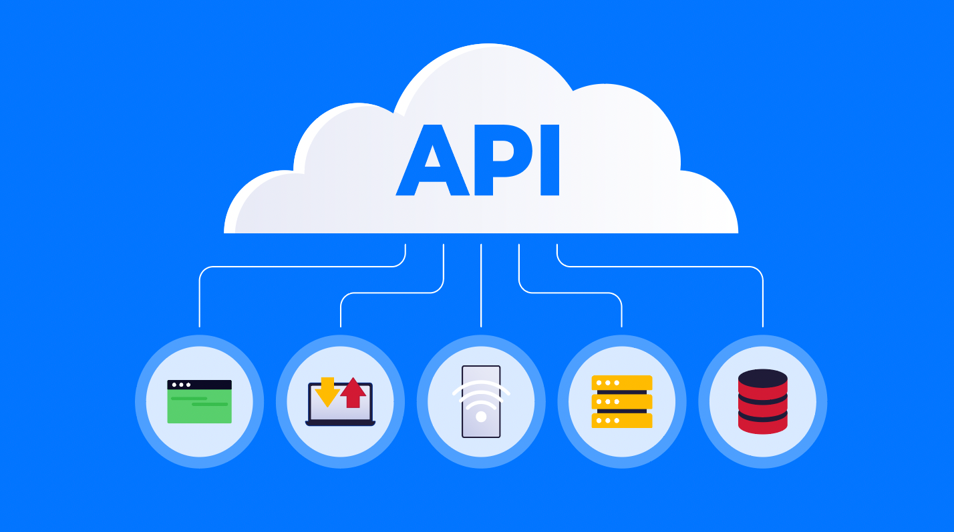
Reasons for API
Graphhopper:
includes the coordination of locations
shows the distance and time between 2 locations
based on the mode of mobility.
1
Whisper API and Graphhopper API integration
Search via Voice Command
2
OpenWeather API
includes information about the weather in different locations
3
GPT 4 API
get customized info about the place of your choice
ask general questions ( like the GPT chatbot)
4

Slide 7
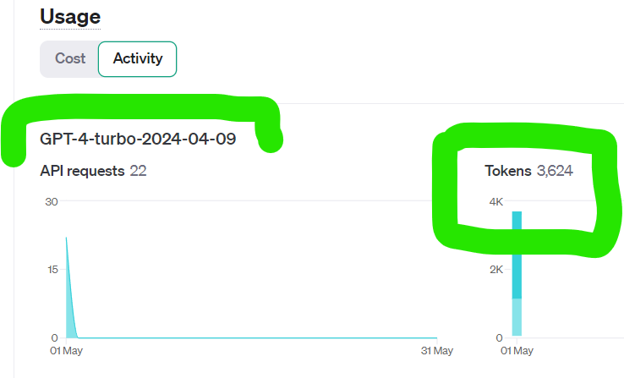
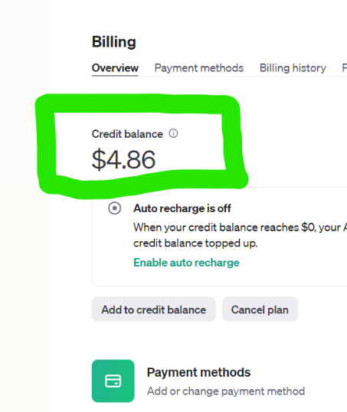
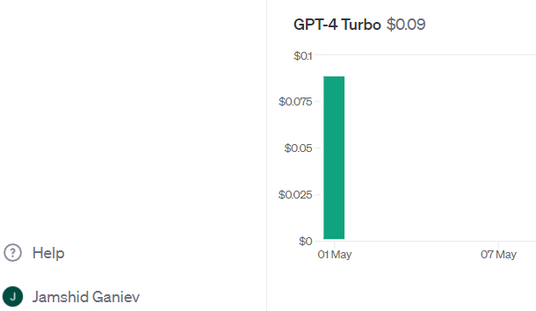
GPT-4-Turbo API

Slide 8
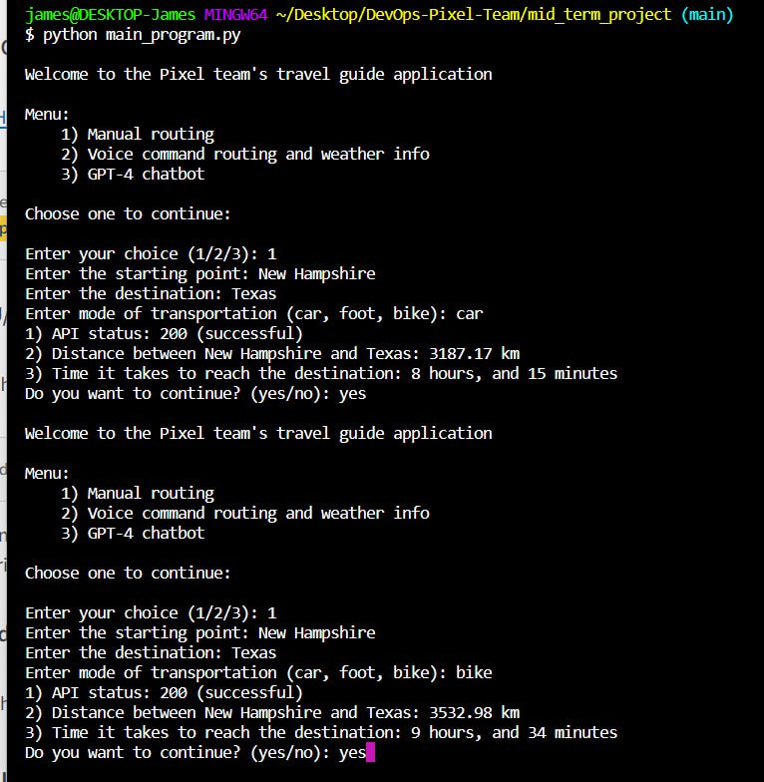
Final Output Menu:1

Slide 9
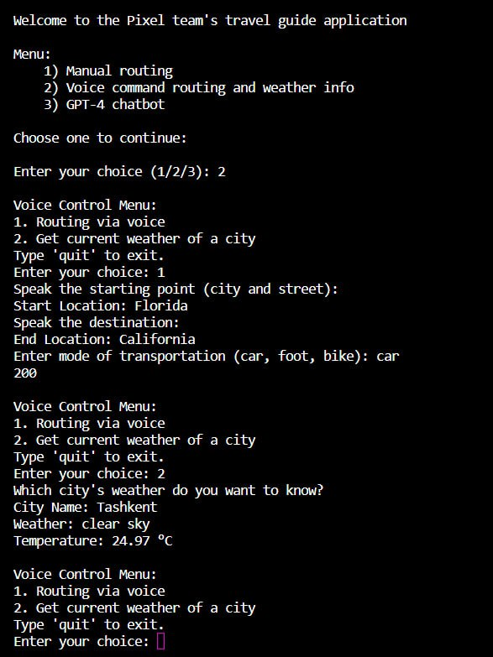
Final Output
Menu: 2

Slide 10
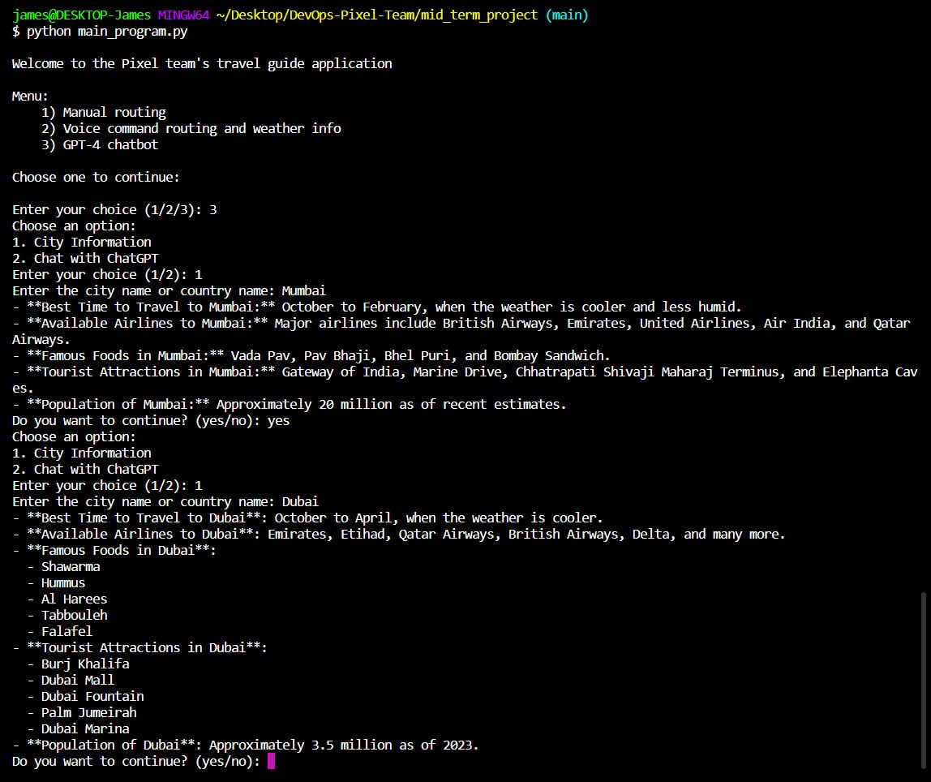
Final Output Menu: 3

Slide 11

Issues
Problem: Whisper API couldn’t recognize the user’s speech and retrieve the data in the beginning Solutions:
updated the code version
used microphone for better voice quality
Problem: many errors in the integration of Whisper and Graphhopper APIs Solution: identifying specific API endpoints for speech reconginition and routing

Slide 12

Future Improvements
Ability to find available flight tickets
Ability to provide some tour programs for the users
The design of the User Interface. (Mobile / Web App)

Slide 13
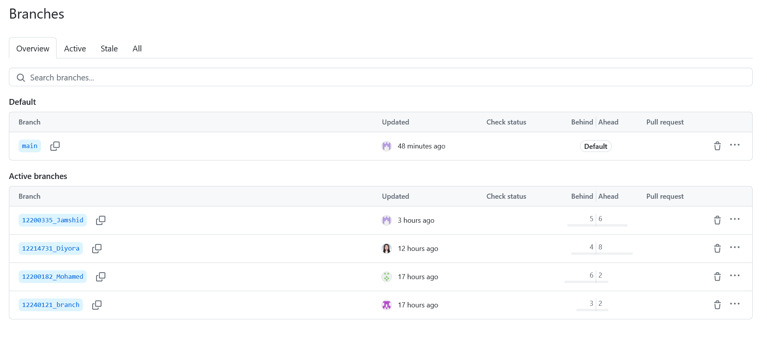

Slide 14
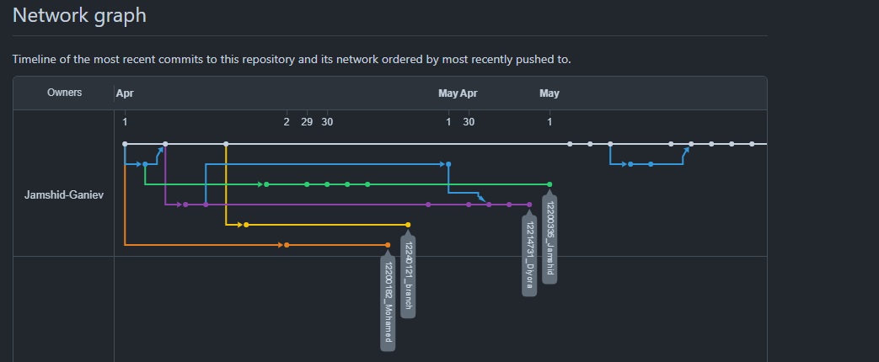
Branch Contribution

Slide 15


Pixel Team
GitHub Collabration
Let's begin!
There are our team’s github screenshots. We did different branches in our own Virtual Machine.

Slide 16
Summary
Happy to work with every member，We worked on some technical difficulties together, and I learned a lot when reviewing the code in the github.
Zhang Xiaomeng
During the processing of this project we learnt a lot about how to plan our work in advance using a white board.
We know about the details of API and we can help someone to find the reasonable way.
We also got to know how to look thorough various API documentations on their official website.
I learnt how to use various APIs in our project and handle different kind of errors (like 400) and also deal with them on the go. I realized that planning our code on the white board before starting the coding process helped our team a great deal.
Jamshid
I learnt how to integrate different APIs into our main project
I learned how to use Whisper API for voice transcription.
Mohamed
Diyora

Slide 17
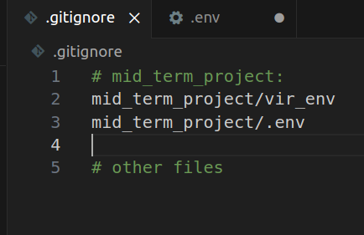
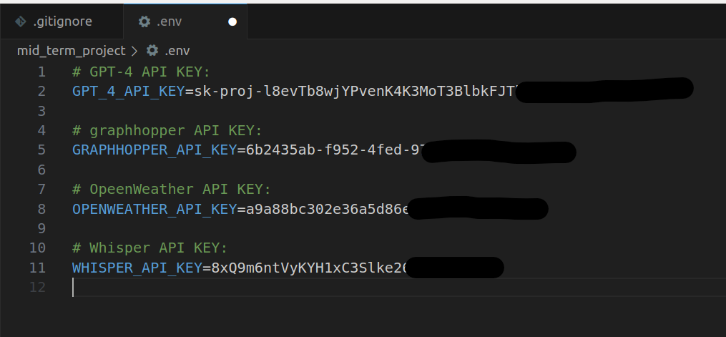
This is how we maintained the security of our API keys.

Slide 18

Pixel Team
Thank you!
Have a great day ahead.

